Slide 1
OBJECT RECOGNITION IN ARTIFICIAL INTELLIGENCE
BHARGAVI MADHUNALA

Slide 2
Object Recognition
What is object recognition?
Object recognition is the area of artificial intelligence(AI) concerned with the abilities of robots and other AI implementations to recognize various things and entities.

Slide 3
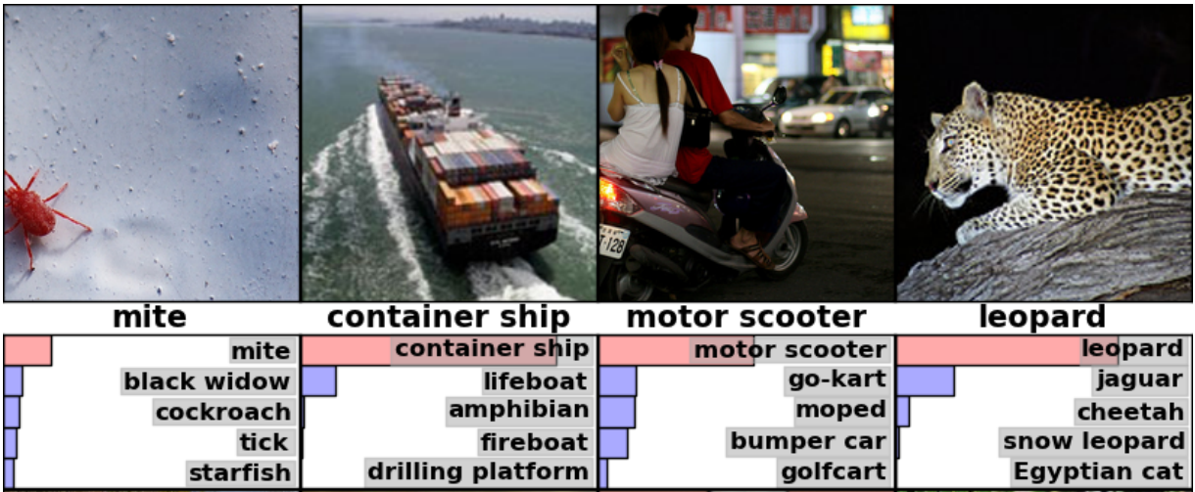

Slide 4
Two main arguments
Image
Size

Slide 5
Difficulties
Two main problems in object recognition are:
1. translation
2. Multiple objects

Slide 6
Cont.…
Translation: Object appearing in a different place in the image.
Multiple objects: Two objects are touching or overlapping, possibly letting them be identified as one.

Slide 7
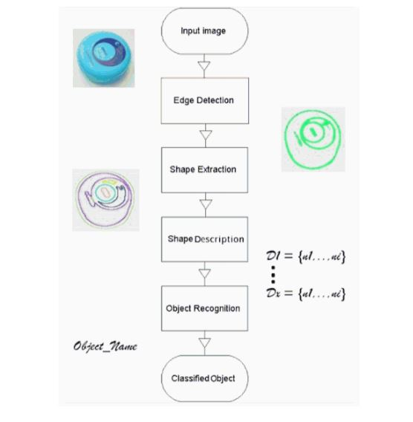

Slide 8
Dataset
Pixel size : 32x32
Uses logical regression.

Slide 9
Keras
Keras is a high-level neural networks library, written in Python and capable of running on top of either TensorFlow.
TensorFlow is an open source software library for machine learning in various kinds of perceptual and language understanding tasks.

Slide 10
Sliding window
Sliding windows play an integral role in object classification, as they allow us to localize exactly where in an image an object resides.

Slide 11
By combining a sliding window with an image pyramid we are able to localize and detect objects in images at multiple scales and locations.

Slide 12
Defaults using Sliding Window
If image is substantially larger than your 64128 window, then you should apply an image pyramid.

Slide 13
Problems using Sliding Window
While using sliding we need to use openCV.
Using open CV will give compatibility issues.

Slide 14
Open CV
OpenCV (Open Source Computer Vision) is a library of programming functions mainly aimed at real-time computer vision.

Slide 15
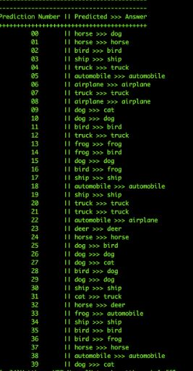

Slide 16
References
http://www.ai.rug.nl/~mwiering/ObjectRecognition.pdf
https://www.cs.toronto.edu/~kriz/cifar.html

